Slide 1
Module 10: LAN Security Concepts
Instructor Materials
Switching, Routing and Wireless Essentials v7.0 (SRWE)
Notes:
Cisco Networking Academy Program
Switching, Routing and Wireless Essentials v7.0 (SRWE)
Module 10: LAN Security Concepts

Slide 2
Instructor Materials – Module 10 Planning Guide
This PowerPoint deck is divided in two parts:
Instructor Planning Guide
Information to help you become familiar with the module
Teaching aids
Instructor Class Presentation
Optional slides that you can use in the classroom
Begins on slide # 9
Note: Remove the Planning Guide from this presentation before sharing with anyone.
For additional help and resources go to the Instructor Home Page and Course Resources for this course. You also can visit the professional development site on netacad.com, the official Cisco Networking Academy Facebook page, or Instructor Only FB group.
Notes:
2

Slide 3
What to Expect in this Module
To facilitate learning, the following features within the GUI may be included in this module:
Feature | Description
Animations | Expose learners to new skills and concepts.
Videos | Expose learners to new skills and concepts.
Check Your Understanding(CYU) | Per topic online quiz to help learners gauge content understanding.
Interactive Activities | A variety of formats to help learners gauge content understanding.
Syntax Checker | Small simulations that expose learners to Cisco command line to practice configuration skills.
PT Activity | Simulation and modeling activities designed to explore, acquire, reinforce, and expand skills.

Slide 4
What to Expect in this Module (Cont.)
To facilitate learning, the following features may be included in this module:
Feature | Description
Hands-On Labs | Labs designed for working with physical equipment.
Class Activities | These are found on the Instructor Resources page. Class Activities are designed to facilitate learning, class discussion, and collaboration.
Module Quizzes | Self-assessments that integrate concepts and skills learned throughout the series of topics presented in the module.
Module Summary | Briefly recaps module content.

Slide 5
Check Your Understanding
Check Your Understanding activities are designed to let students quickly determine if they understand the content and can proceed, or if they need to review.
Check Your Understanding activities do not affect student grades.
There are no separate slides for these activities in the PPT. They are listed in the notes area of the slide that appears before these activities.
Notes:
5

Slide 6
Module 10: Activities
What activities are associated with this module?
Page # | Activity Type | Activity Name | Optional?
10.1.6 | Check Your Understanding | Endpoint Security | Recommended
10.2.7 | Check Your Understanding | Access Control | Recommended
10.3.4 | Check Your Understanding | Layer 2 Security Threats | Recommended
10.4.4 | Check Your Understanding | MAC Address Table Attacks | Recommended
10.5.1 | Video | VLAN and DHCP Attacks | Recommended
10.5.6 | Video | ARP Attacks, STP Attacks, and CDP Reconnaissance | Recommended
10.5.11 | Check Your Understanding | LAN Attacks | Recommended
Notes:
6

Slide 7
Module 10: Best Practices
Prior to teaching Module 10, the instructor should:
Review the activities and assessments for this module.
Try to include as many questions as possible to keep students engaged during classroom presentation.
Topic 10.1
Ask the students or have a class discussion
What is another threat that you can think of?
What methods do you employ to protect yourself against SPAM and phishing?
Topic 10.2
Ask the students or have a class discussion
Can you think of an instance where using a local database would be preferable to using a centralized database?
Why is layer 2 security so important?
Notes:
7

Slide 8
Module 10: Best Practices (Cont.)
Topic 10.3
Ask the students or have a class discussion
What configuration or process do you consider to be the cornerstone of layer 2 security?
In what instances would a dedicated management VLAN be too cumbersome to implement?
Topic 10.4
Ask the students or have a class discussion
Do you know of any other tools that could generate a MAC address flooding attack?
What is the danger in the flooding of unknown unicast frames?
Topic 10.5
Ask the students or have a class discussion
What configuration(s) could you implement to prevent unauthorized trunks, and thus VLAN Hopping attacks?
Where in the network should a layer 2 discovery protocol be enabled?
Notes:
8

Slide 9
Module 10: LAN Security Concepts
Switching, Routing and Wireless Essentials v7.0 (SRWE)
Notes:
Cisco Networking Academy Program
Switching, Routing and Wireless Essentials v7.0 (SRWE)
Module 10: LAN Security Concepts

Slide 10
Module Objectives
Module Title: LAN Security Concepts
Module Objective: Explain how vulnerabilities compromise LAN security
Topic Title | Topic Objective
Endpoint Security | Explain how to use endpoint security to mitigate attacks
Access Control | Explain how AAA and 802.1x are used to authenticate LAN endpoints and devices
Layer 2 Security Threats | Identify Layer 2 vulnerabilities
MAC Address Table Attack | Explain how a MAC address table attack compromised LAN security
LAN Attacks | Explain how LAN attacks compromise LAN security
Notes:
10
10- Introduction
10.0.2 – What will I learn in this module

Slide 11
10.1 Endpoint Security
Notes:
10 – LAN Security Concepts
10.1 – Endpoint Security

Slide 12
Endpoint Security Network Attacks Today
The news media commonly covers attacks on enterprise networks. Simply search the internet for “latest network attacks” to find up-to-date information on current attacks. Most likely, these attacks will involve one or more of the following:
Distributed Denial of Service (DDoS) – This is a coordinated attack from many devices, called zombies, with the intention of degrading or halting public access to an organization’s website and resources.
Data Breach – This is an attack in which an organization’s data servers or hosts are compromised to steal confidential information.
Malware – This is an attack in which an organization’s hosts are infected with malicious software that cause a variety of problems. For example, ransomware such as WannaCry encrypts the data on a host and locks access to it until a ransom is paid.
Notes:
10 – LAN Security Concepts
10.1 – Endpoint Security
10.1.1 – Network Attacks Today

Slide 13
Endpoint Security Network Security Devices
Various network security devices are required to protect the network perimeter from outside access. These devices could include the following:
Virtual Private Network (VPN) enabled router - provides a secure connection to remote users across a public network and into the enterprise network. VPN services can be integrated into the firewall.
Next-Generation Firewall (NGFW) - provides stateful packet inspection, application visibility and control, a next-generation intrusion prevention system (NGIPS), advanced malware protection (AMP), and URL filtering.
Network Access Control (NAC) - includes authentication, authorization, and accounting (AAA) services. In larger enterprises, these services might be incorporated into an appliance that can manage access policies across a wide variety of users and device types. The Cisco Identity Services Engine (ISE) is an example of a NAC device.
Notes:
10 – LAN Security Concepts
10.1 – Endpoint Security
10.1.2 – Network Security Devices

Slide 14
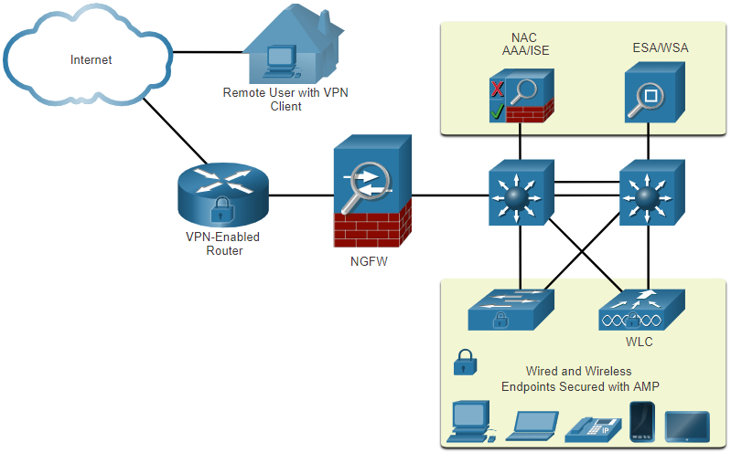
Endpoint Security Endpoint Protection
Endpoints are hosts which commonly consist of laptops, desktops, servers, and IP phones, as well as employee-owned devices. Endpoints are particularly susceptible to malware-related attacks that originate through email or web browsing.
Endpoints have typically used traditional host-based security features, such as antivirus/antimalware, host-based firewalls, and host-based intrusion prevention systems (HIPSs).
Endpoints today are best protected by a combination of NAC, AMP software, an email security appliance (ESA), and a web security appliance (WSA).
Notes:
10 – LAN Security Concepts
10.1 – Endpoint Security
10.1.3 – Endpoint Protection

Slide 15
Endpoint Security Cisco Email Security Appliance
The Cisco ESA device is designed to monitor Simple Mail Transfer Protocol (SMTP). The Cisco ESA is constantly updated by real-time feeds from the Cisco Talos, which detects and correlates threats and solutions by using a worldwide database monitoring system. This threat intelligence data is pulled by the Cisco ESA every three to five minutes.
These are some of the functions of the Cisco ESA:
Block known threats
Remediate against stealth malware that evaded initial detection
Discard emails with bad links
Block access to newly infected sites.
Encrypt content in outgoing email to prevent data loss.
Notes:
10 – LAN Security Concepts
10.1 – Endpoint Security
10.1.4 – Cisco Email Security Appliance

Slide 16
Endpoint Security Cisco Web Security Appliance
The Cisco Web Security Appliance (WSA) is a mitigation technology for web-based threats. It helps organizations address the challenges of securing and controlling web traffic.
The Cisco WSA combines advanced malware protection, application visibility and control, acceptable use policy controls, and reporting.
Cisco WSA provides complete control over how users access the internet. Certain features and applications, such as chat, messaging, video and audio, can be allowed, restricted with time and bandwidth limits, or blocked, according to the organization’s requirements.
The WSA can perform blacklisting of URLs, URL-filtering, malware scanning, URL categorization, Web application filtering, and encryption and decryption of web traffic.
Notes:
10 – LAN Security Concepts
10.1 – Endpoint Security
10.1.5 – Cisco Web Security Appliance
10.1.6 – Check Your Understanding – Endpoint Security

Slide 17
10.2 Access Control
Notes:
10 – LAN Security Concepts
10.2 – Access Control

Slide 18

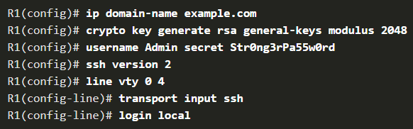
Access Control Authentication with a Local Password
Many types of authentication can be performed on networking devices, and each method offers varying levels of security.
The simplest method of remote access authentication is to configure a login and password combination on console, vty lines, and aux ports.
SSH is a more secure form of remote access:
It requires a username and a password.
The username and password can be authenticated locally.
The local database method has some limitations:
User accounts must be configured locally on each device which is not scalable.
The method provides no fallback authentication method.
Notes:
10 – LAN Security Concepts
10.2 – Access Control
10.2.1 – Authentication with a Local Password

Slide 19
Access Control AAA Components
AAA stands for Authentication, Authorization, and Accounting, and provides the primary framework to set up access control on a network device.
AAA is a way to control who is permitted to access a network (authenticate), what they can do while they are there (authorize), and to audit what actions they performed while accessing the network (accounting).
Notes:
10 – LAN Security Concepts
10.2 – Access Control
10.2.2 – AAA Components

Slide 20
Access Control Authentication
Local and server-based are two common methods of implementing AAA authentication.
Local AAA Authentication:
Method stores usernames and passwords locally in a network device (e.g., Cisco router).
Users authenticate against the local database.
Local AAA is ideal for small networks.
Server-Based AAA Authentication:
With the server-based method, the router accesses a central AAA server.
The AAA server contains the usernames and password for all users.
The router uses either the Remote Authentication Dial-In User Service (RADIUS) or Terminal Access Controller Access Control System (TACACS+) protocols to communicate with the AAA server.
When there are multiple routers and switches, server-based AAA is more appropriate.
Notes:
10 – LAN Security Concepts
10.2 – Access Control
10.2.3 - Authentication

Slide 21
Access Control Authorization
AAA authorization is automatic and does not require users to perform additional steps after authentication.
Authorization governs what users can and cannot do on the network after they are authenticated.
Authorization uses a set of attributes that describes the user’s access to the network. These attributes are used by the AAA server to determine privileges and restrictions for that user.
Notes:
10 – LAN Security Concepts
10.2 – Access Control
10.2.4 - Authorization

Slide 22
Access Control Accounting
AAA accounting collects and reports usage data. This data can be used for such purposes as auditing or billing. The collected data might include the start and stop connection times, executed commands, number of packets, and number of bytes.
A primary use of accounting is to combine it with AAA authentication.
The AAA server keeps a detailed log of exactly what the authenticated user does on the device, as shown in the figure. This includes all EXEC and configuration commands issued by the user.
The log contains numerous data fields, including the username, the date and time, and the actual command that was entered by the user. This information is useful when troubleshooting devices. It also provides evidence for when individuals perform malicious acts.
Notes:
10 – LAN Security Concepts
10.2 – Access Control
10.2.5 - Accounting

Slide 23
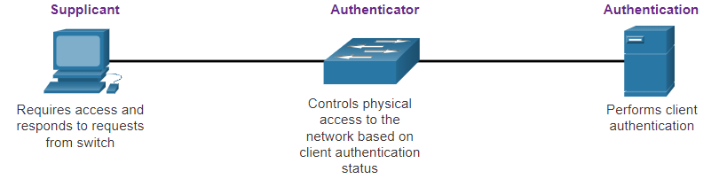
Access Control 802.1X
The IEEE 802.1X standard is a port-based access control and authentication protocol. This protocol restricts unauthorized workstations from connecting to a LAN through publicly accessible switch ports. The authentication server authenticates each workstation that is connected to a switch port before making available any services offered by the switch or the LAN.
With 802.1X port-based authentication, the devices in the network have specific roles:
Client (Supplicant) - This is a device running 802.1X-compliant client software, which is available for wired or wireless devices.
Switch (Authenticator) –The switch acts as an intermediary between the client and the authentication server. It requests identifying information from the client, verifies that information with the authentication server, and relays a response to the client. Another device that could act as authenticator is a wireless access point.
Authentication server –The server validates the identity of the client and notifies the switch or wireless access point that the client is or is not authorized to access the LAN and switch services.
Notes:
10 – LAN Security Concepts
10.2 – Access Control
10.2.6 – 802.1X
10.2.7 – Check Your Understanding – Access Control

Slide 24
10.3 Layer 2 Security Threats
Notes:
10 – LAN Security Concepts
10.3 – Layer 2 Security Threats

Slide 25
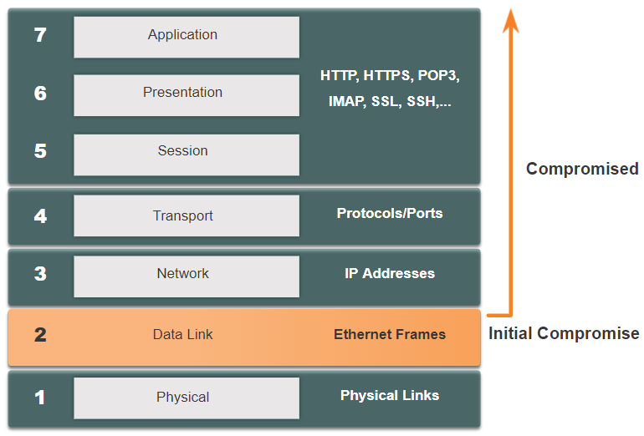
Layer 2 Security Threats Layer 2 Vulnerabilities
Recall that the OSI reference model is divided into seven layers which work independently of each other. The figure shows the function of each layer and the core elements that can be exploited.
Network administrators routinely implement security solutions to protect the elements in Layer 3 up through Layer 7. They use VPNs, firewalls, and IPS devices to protect these elements. However, if Layer 2 is compromised, then all the layers above it are also affected. For example, if a threat actor with access to the internal network captured Layer 2 frames, then all the security implemented on the layers above would be useless. The threat actor could cause a lot of damage on the Layer 2 LAN networking infrastructure.
Notes:
10 – LAN Security Concepts
10.3 – Layer 2 Security Threats
10.3.1 - Layer 2 Vulnerabilities

Slide 26
Layer 2 Security Threats Switch Attack Categories
Security is only as strong as the weakest link in the system, and Layer 2 is considered to be that weak link. This is because LANs were traditionally under the administrative control of a single organization. We inherently trusted all persons and devices connected to our LAN. Today, with BYOD and more sophisticated attacks, our LANs have become more vulnerable to penetration.
Category | Examples
MAC Table Attacks | Includes MAC address flooding attacks.
VLAN Attacks | Includes VLAN hopping and VLAN double-tagging attacks. It also includes attacks between devices on a common VLAN.
DHCP Attacks | Includes DHCP starvation and DHCP spoofing attacks.
ARP Attacks | Includes ARP spoofing and ARP poisoning attacks.
Address Spoofing Attacks | Includes MAC address and IP address spoofing attacks.
STP Attacks | Includes Spanning Tree Protocol manipulation attacks.
Notes:
10 – LAN Security Concepts
10.3 – Layer 2 Security Threats
10.3.2 - Switch Attack Categories

Slide 27
Layer 2 Security Threats Switch Attack Mitigation Techniques
Solution | Description
Port Security | Prevents many types of attacks including MAC address flooding attacks and DHCP starvation attacks.
DHCP Snooping | Prevents DHCP starvation and DHCP spoofing attacks.
Dynamic ARP Inspection (DAI) | Prevents ARP spoofing and ARP poisoning attacks.
IP Source Guard (IPSG) | Prevents MAC and IP address spoofing attacks.
These Layer 2 solutions will not be effective if the management protocols are not secured. The following strategies are recommended:
Always use secure variants of management protocols such as SSH, Secure Copy Protocol (SCP), Secure FTP (SFTP), and Secure Socket Layer/Transport Layer Security (SSL/TLS).
Consider using out-of-band management network to manage devices.
Use a dedicated management VLAN where nothing but management traffic resides.
Use ACLs to filter unwanted access.
Notes:
10 – LAN Security Concepts
10.3 – Layer 2 Security Threats
10.3.3 - Switch Attack Mitigation Techniques
10.3.4 – Check Your Understanding– Layer 2 Security Threats

Slide 28
10.4 MAC Address Table Attack
Notes:
10 – LAN Security Concepts
10.4 – MAC Address Table Attack

Slide 29
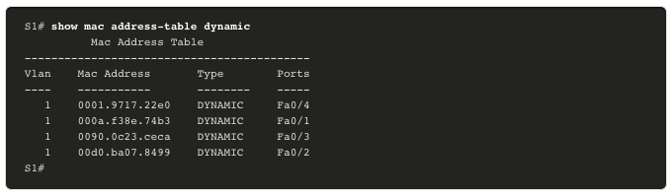
MAC Address Table Attack Switch Operation Review
Recall that to make forwarding decisions, a Layer 2 LAN switch builds a table based on the source MAC addresses in received frames. This is called a MAC address table. MAC address tables are stored in memory and are used to more efficiently switch frames.
Notes:
10 – LAN Security Concepts
10.4 – MAC Address Table Attack
10.4.1 – Switch Operation Review

Slide 30
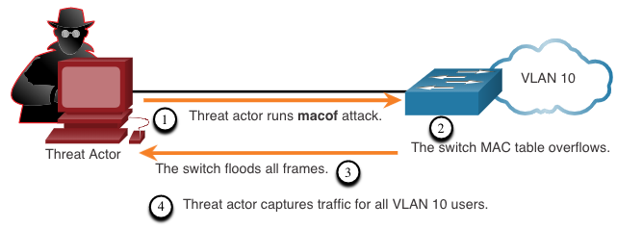
MAC Address Table Attack MAC Address Table Flooding
All MAC tables have a fixed size and consequently, a switch can run out of resources in which to store MAC addresses. MAC address flooding attacks take advantage of this limitation by bombarding the switch with fake source MAC addresses until the switch MAC address table is full.
When this occurs, the switch treats the frame as an unknown unicast and begins to flood all incoming traffic out all ports on the same VLAN without referencing the MAC table. This condition now allows a threat actor to capture all of the frames sent from one host to another on the local LAN or local VLAN.
Note: Traffic is flooded only within the local LAN or VLAN. The threat actor can only capture traffic within the local LAN or VLAN to which the threat actor is connected.
Notes:
10 – LAN Security Concepts
10.4 – MAC Address Table Attack
10.4.2 – MAC Address Table Flooding

Slide 31
MAC Address Table Attack MAC Address Table Attack Mitigation
What makes tools such as macof so dangerous is that an attacker can create a MAC table overflow attack very quickly. For instance, a Catalyst 6500 switch can store 132,000 MAC addresses in its MAC address table. A tool such as macof can flood a switch with up to 8,000 bogus frames per second; creating a MAC address table overflow attack in a matter of a few seconds.
Another reason why these attack tools are dangerous is because they not only affect the local switch, they can also affect other connected Layer 2 switches. When the MAC address table of a switch is full, it starts flooding out all ports including those connected to other Layer 2 switches.
To mitigate MAC address table overflow attacks, network administrators must implement port security. Port security will only allow a specified number of source MAC addresses to be learned on the port. Port security is further discussed in another module.
Notes:
10 – LAN Security Concepts
10.4 – MAC Address Table Attack
10.4.3 – MAC Address Table Attack Mitigation
10.4.4 – Check Your Understanding – MAC Address Table Attacks

Slide 32
10.5 LAN Attacks
Notes:
10 – LAN Security Concepts
10.5 – LAN Attacks

Slide 33
LAN Attacks Video – VLAN and DHCP Attacks
This video will cover the following:
VLAN Hopping Attack
VLAN Double-Tagging Attack
DHCP Starvation Attack
DHCP Spoofing Attack
Notes:
10 – LAN Security Concepts
10.5 – LAN Attacks
10.5.1 – Video – VLAN and DHCP Attacks

Slide 34
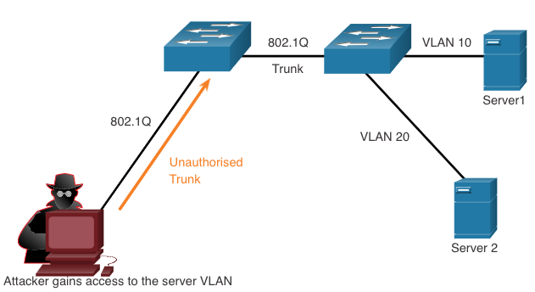
LAN Attacks VLAN Hopping Attacks
A VLAN hopping attack enables traffic from one VLAN to be seen by another VLAN without the aid of a router. In a basic VLAN hopping attack, the threat actor configures a host to act like a switch to take advantage of the automatic trunking port feature enabled by default on most switch ports.
The threat actor configures the host to spoof 802.1Q signaling and Cisco-proprietary Dynamic Trunking Protocol (DTP) signaling to trunk with the connecting switch. If successful, the switch establishes a trunk link with the host, as shown in the figure. Now the threat actor can access all the VLANs on the switch. The threat actor can send and receive traffic on any VLAN, effectively hopping between VLANs.
Notes:
10 – LAN Security Concepts
10.5 – LAN Attacks
10.5.2 – VLAN Hopping Attacks

Slide 35
LAN Attacks VLAN Double-Tagging Attacks
A threat actor is specific situations could embed a hidden 802.1Q tag inside the frame that already has an 802.1Q tag. This tag allows the frame to go to a VLAN that the original 802.1Q tag did not specify.
Step 1: The threat actor sends a double-tagged 802.1Q frame to the switch. The outer header has the VLAN tag of the threat actor, which is the same as the native VLAN of the trunk port.
Step 2: The frame arrives on the first switch, which looks at the first 4-byte 802.1Q tag. The switch sees that the frame is destined for the native VLAN. The switch forwards the packet out all native VLAN ports after stripping the VLAN tag. The frame is not retagged because it is part of the native VLAN. At this point, the inner VLAN tag is still intact and has not been inspected by the first switch.
Step 3: The frame arrives at the second switch which has no knowledge that it was supposed to be for the native VLAN. Native VLAN traffic is not tagged by the sending switch as specified in the 802.1Q specification. The second switch looks only at the inner 802.1Q tag that the threat actor inserted and sees that the frame is destined the target VLAN. The second switch sends the frame on to the target or floods it, depending on whether there is an existing MAC address table entry for the target.
Notes:
10 – LAN Security Concepts
10.5 – LAN Attacks
10.5.3 – VLAN Double-Tagging Attacks

Slide 36
LAN Attacks VLAN Double-Tagging Attacks (Cont.)
A VLAN double-tagging attack is unidirectional and works only when the attacker is connected to a port residing in the same VLAN as the native VLAN of the trunk port. The idea is that double tagging allows the attacker to send data to hosts or servers on a VLAN that otherwise would be blocked by some type of access control configuration. Presumably the return traffic will also be permitted, thus giving the attacker the ability to communicate with devices on the normally blocked VLAN.
VLAN Attack Mitigation - VLAN hopping and VLAN double-tagging attacks can be prevented by implementing the following trunk security guidelines, as discussed in a previous module:
Disable trunking on all access ports.
Disable auto trunking on trunk links so that trunks must be manually enabled.
Be sure that the native VLAN is only used for trunk links.
Notes:
10 – LAN Security Concepts
10.5 – LAN Attacks
10.5.3 – VLAN Double-Tagging Attacks (Cont.)

Slide 37
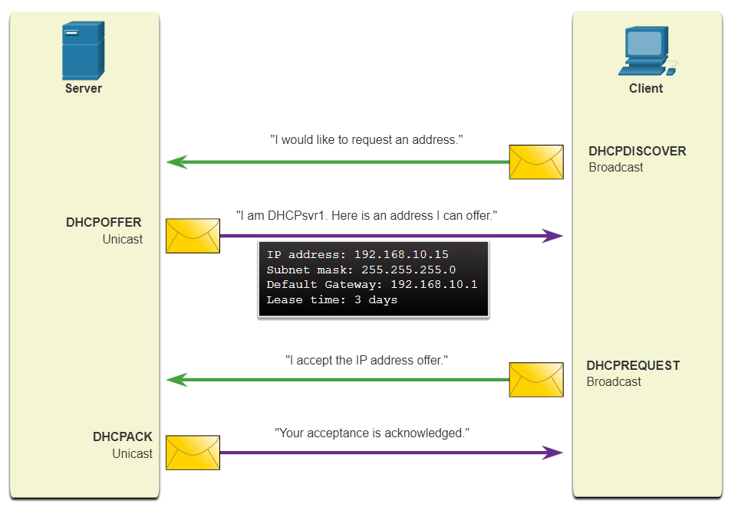
LAN Attacks DHCP Messages
DHCP servers dynamically provide IP configuration information including IP address, subnet mask, default gateway, DNS servers, and more to clients. A review of the sequence of the DHCP message exchange between client and server is show in the figure.
Notes:
10 – LAN Security Concepts
10.5 – LAN Attacks
10.5.4 – DHCP Messages

Slide 38
LAN Attacks DHCP Attacks
Two types of DHCP attacks are DHCP starvation and DHCP spoofing. Both attacks are mitigated by implementing DHCP snooping.
DHCP Starvation Attack – The goal of this attack is to create a DoS for connecting clients. DHCP starvation attacks require an attack tool such as Gobbler. Gobbler has the ability to look at the entire scope of leasable IP addresses and tries to lease them all. Specifically, it creates DHCP discovery messages with bogus MAC addresses.
DHCP Spoofing Attack – This occurs when a rogue DHCP server is connected to the network and provides false IP configuration parameters to legitimate clients. A rogue server can provide a variety of misleading information, including the following:
Wrong default gateway - The rogue server provides an invalid gateway or the IP address of its host to create a man-in-the-middle attack. This may go entirely undetected as the intruder intercepts the data flow through the network.
Wrong DNS server - The rogue server provides an incorrect DNS server address pointing the user to a nefarious website.
Wrong IP address - The rogue server provides an invalid IP address effectively creating a DoS attack on the DHCP client.
Notes:
10 – LAN Security Concepts
10.5 – LAN Attacks
10.5.5 – DHCP Attacks

Slide 39
LAN Attacks Video – ARP Attacks, STP Attacks, and CDP Reconnaissance
This video will cover the following:
ARP Spoofing Attack
ARP Poisoning Attack
STP Attack
CDP Reconnaissance
Notes:
10 – LAN Security Concepts
10.5 – LAN Attacks
10.5.6 - Video – ARP Attacks, STP Attacks, and CDP Reconnaissance

Slide 40
LAN Attacks ARP Attacks
Hosts broadcast ARP Requests to determine the MAC address of a host with a destination IP address. All hosts on the subnet receive and process the ARP Request. The host with the matching IP address in the ARP Request sends an ARP Reply.
A client can send an unsolicited ARP Reply called a “gratuitous ARP”. Other hosts on the subnet store the MAC address and IP address contained in the gratuitous ARP in their ARP tables.
An attacker can send a gratuitous ARP message containing a spoofed MAC address to a switch, and the switch would update its MAC table accordingly. In a typical attack, a threat actor sends unsolicited ARP Replies to other hosts on the subnet with the MAC Address of the threat actor and the IP address of the default gateway, effectively setting up a man-in-the-middle attack.
There are many tools available on the internet to create ARP man-in-the-middle attacks.
IPv6 uses ICMPv6 Neighbor Discovery Protocol for Layer 2 address resolution. IPv6 includes strategies to mitigate Neighbor Advertisement spoofing, similar to the way IPv6 prevents a spoofed ARP Reply.
ARP spoofing and ARP poisoning are mitigated by implementing Dynamic ARP Inspection (DAI).
Notes:
10 – LAN Security Concepts
10.5 – LAN Attacks
10.5.7- ARP Attacks

Slide 41
LAN Attacks Address Spoofing Attacks
IP address spoofing is when a threat actor hijacks a valid IP address of another device on the subnet or uses a random IP address. IP address spoofing is difficult to mitigate, especially when it is used inside a subnet in which the IP belongs.
MAC address spoofing attacks occur when the threat actors alter the MAC address of their host to match another known MAC address of a target host. The switch overwrites the current MAC table entry and assigns the MAC address to the new port. It then inadvertently forwards frames destined for the target host to the attacking host.
When the target host sends traffic, the switch will correct the error, realigning the MAC address to the original port. To stop the switch from returning the port assignment to its correct state, the threat actor can create a program or script that will constantly send frames to the switch so that the switch maintains the incorrect or spoofed information.
There is no security mechanism at Layer 2 that allows a switch to verify the source of MAC addresses, which is what makes it so vulnerable to spoofing.
IP and MAC address spoofing can be mitigated by implementing IP Source Guard (IPSG).
Notes:
10 – LAN Security Concepts
10.5 – LAN Attacks
10.5.8 – Address Spoofing Attacks

Slide 42
LAN Attacks STP Attack
Network attackers can manipulate the Spanning Tree Protocol (STP) to conduct an attack by spoofing the root bridge and changing the topology of a network. Attackers can then capture all traffic for the immediate switched domain.
To conduct an STP manipulation attack, the attacking host broadcasts STP bridge protocol data units (BPDUs) containing configuration and topology changes that will force spanning-tree recalculations. The BPDUs sent by the attacking host announce a lower bridge priority in an attempt to be elected as the root bridge.
This STP attack is mitigated by implementing BPDU Guard on all access ports. BPDU Guard is discussed in more detail later in the course.
Notes:
10 – LAN Security Concepts
10.5 – LAN Attacks
10.5.9 – STP Attack

Slide 43
LAN Attacks CDP Reconnaissance
The Cisco Discovery Protocol (CDP) is a proprietary Layer 2 link discovery protocol. It is enabled on all Cisco devices by default. Network administrators also use CDP to help configure and troubleshoot network devices. CDP information is sent out CDP-enabled ports in periodic, unencrypted, unauthenticated broadcasts. CDP information includes the IP address of the device, IOS software version, platform, capabilities, and the native VLAN. The device receiving the CDP message updates its CDP database.
To mitigate the exploitation of CDP, limit the use of CDP on devices or ports. For example, disable CDP on edge ports that connect to untrusted devices.
To disable CDP globally on a device, use the no cdp run global configuration mode command. To enable CDP globally, use the cdp run global configuration command.
To disable CDP on a port, use the no cdp enable interface configuration command. To enable CDP on a port, use the cdp enable interface configuration command.
Note: Link Layer Discovery Protocol (LLDP) is also vulnerable to reconnaissance attacks. Configure no lldp run to disable LLDP globally. To disable LLDP on the interface, configure no lldp transmit and no lldp receive.
Notes:
10 – LAN Security Concepts
10.5 – LAN Attacks
10.5.10 – CDP Reconnaissance
10.5.11 – Check Your Understanding – LAN Attacks

Slide 44
10.6 Module Practice and Quiz
Notes:
10 – LAN Security Concepts
10.6 – Module Practice and Quiz

Slide 45
Module Practice and Quiz What Did I Learn In This Module?
Endpoints are particularly susceptible to malware-related attacks that originate through email or web browsing, such as DDOS, date breaches, and malware. These endpoints have typically used traditional host-based security features, such as antivirus/antimalware, host-based firewalls, and host-based intrusion prevention systems (HIPSs). Endpoints are best protected by a combination of NAC, host-based AMP software, an email security appliance (ESA), and a web security appliance (WSA).
AAA controls who is permitted to access a network (authenticate), what they can do while they are there (authorize), and to audit what actions they performed while accessing the network (accounting).
The IEEE 802.1X standard is a port-based access control and authentication protocol that restricts unauthorized workstations from connecting to a LAN through publicly accessible switch ports.
If Layer 2 is compromised, then all layers above it are also affected. The first step in mitigating attacks on the Layer 2 infrastructure is to understand the underlying operation of Layer 2 and the Layer 2 solutions: Port Security, DHCP Snooping, DAI, and IPSG. These won’t work unless management protocols are secured.
Notes:
10 – LAN Security Concepts
10.6 – Module Practice and Quiz
10.6.1 – What did I learn in this module?

Slide 46
Module Practice and Quiz What Did I Learn In This Module? (Cont.)
MAC address flooding attacks bombard the switch with fake source MAC addresses until the switch MAC address table is full.
A VLAN hopping attack enables traffic from one VLAN to be seen by another VLAN without the aid of a router.
A VLAN double-tagging attack is unidirectional and works only when the threat actor is connected to a port residing in the same VLAN as the native VLAN of the trunk port.
VLAN hopping and VLAN double-tagging attacks can be prevented by implementing the following trunk security guidelines:
Disable trunking on all access ports.
Disable auto trunking on trunk links so that trunks must be manually enabled.
Be sure that the native VLAN is only used for trunk links.
Two types of DHCP attacks are DHCP starvation and DHCP spoofing. Both attacks are mitigated by implementing DHCP snooping.
Notes:
10 – LAN Security Concepts
10.6 – Module Practice and Quiz
10.6.1 – What did I learn in this module? (Cont.)

Slide 47
Module Practice and Quiz What Did I Learn In This Module? (Cont.)
ARP Attack: A threat actor sends a gratuitous ARP message containing a spoofed MAC address to a switch, and the switch updates its MAC table accordingly. Now the threat actor sends unsolicited ARP Replies to other hosts on the subnet with the MAC Address of the threat actor and the IP address of the default gateway. ARP spoofing and ARP poisoning are mitigated by implementing DAI.
Address Spoofing Attack: IP address spoofing is when a threat actor hijacks a valid IP address of another device on the subnet or uses a random IP address. MAC address spoofing attacks occur when the threat actors alter the MAC address of their host to match another known MAC address of a target host. IP and MAC address spoofing can be mitigated by implementing IPSG.
STP Attack: Threat actors manipulate STP to conduct an attack by spoofing the root bridge and changing the topology of a network. Threat actors make their hosts appear as root bridges; therefore, capturing all traffic for the immediate switched domain. This STP attack is mitigated by implementing BPDU Guard on all access ports.
CDP Reconnaissance: CDP information is sent out CDP-enabled ports in periodic, unencrypted broadcasts. CDP information includes the IP address of the device, IOS software version, platform, capabilities, and the native VLAN. The device receiving the CDP message updates its CDP database. the information provided by CDP can also be used by a threat actor to discover network infrastructure vulnerabilities. To mitigate the exploitation of CDP, limit the use of CDP on devices or ports.
Notes:
10 – LAN Security Concepts
10.6 – Module Practice and Quiz
10.6.1 – What did I learn in this module? (Cont.)
10.6.2 – Module Quiz – LAN Security Concepts

Slide 48
Module 10: LAN Security Concepts New Terms and Commands
Data Breach
Malware
Next-Generation Firewall (NGFW)
Next-Generation IPS (NGIPS)
Advanced Malware Protection (AMP)
Authentication, Authorization, Accounting (AAA)
Identity Services Engine (ISE)
Host-Based Intrusion Prevention System (HIPS)
Email Security Appliance (ESA)
Web Security Appliance (WSA)
login {local}
Remote Authentication Dial-In User Service (RADIUS)
Terminal Access Controller Access Control System (TACACS+)
IEEE 802.1X
Client (Supplicant)
Authenticator
Port Security
DHCP Snooping
Dynamic ARP Inspection (DAI)
IP Source Guard (IPSG)
VLAN Hopping
VLAN Double-Tagging
DHCP Starvation
DHCP Spoofing
Gratuitous ARP
ARP Spoofing
ARP Poisoning
Cisco Discovery Protocol (CDP)
no cdp run
no cdp enable
no lldp run
no lldp transmit | receive

